Slide 1
Java Collection Framework
Algoritma dan Pemrograman II

Slide 2
Agenda
Week | Topic / Desc
8 | JDBC | Pemberian tugas perorangan | Sudah Membuat kelompok
9 | JDBC 2 | SQL Optimization | collect nama-nama kelompok 5 orang per kelompok
 | E-Learning
10 | Java Collection Framework | Sudah ada Judul Tugas Besar
11 | OOP in Software Design | Class Diagram | Responsi #1 | target approx. : 30%
12 | Introduction to Design Pattern | Responsi #2 | target approx. : 60%
13 | Responsi #3 | target approx. : 90%
UAS

Slide 3
History
Before JDK 1.2 introduced, the standard methods for grouping Java objects were Arrays or Vectors, or Hashtables.
Those method had no common interface, defined independently and had no correlation among them
Very difficult to remember all the different methods, syntax, and constructors

Slide 4
History
To represent a group of objects as a single entity in the Java programming language we need classes and interfaces defined by the Collection Framework

Slide 5
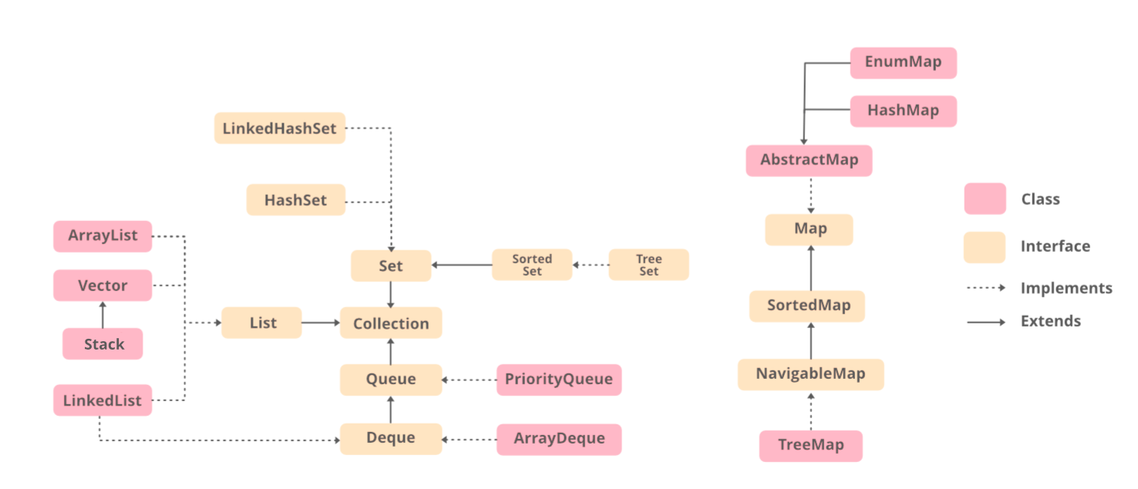
Collection Framework Taxonomy
Source: https://www.geeksforgeeks.org/java-collection-tutorial/

Slide 6
What is Collection?
A collection is simply an object that groups multiple elements into a single unit
Collections are used to store, retrieve and manipulate data, and to transmit data from one method to another

Slide 7
Set
Set Interface: A set is a collection that cannot contain any duplicate elements.
This interface models the mathematical set abstraction.
Set Interface extends Collection Interface.
A set contains no pair of elements e1 and e2 such that e1.equals(e2), and at most one null element.

Slide 8
HashSet
The class HashSet implements the Set Interface.
This class maintains a collection of individual objects and you can do intersection, set difference and iteration over the collection. The hash table makes this operations fast.
This class permits the null element.
HashSet makes no guarantees as to the iteration order of the set, in particular, it does not guarantee that the order will remain constant over time.

Slide 9
TreeSet
TreeSet: this class implements Set interface, backed by a TreeMap instance.
TreeSet guarantees that the sorted set will be in ascending element order, sorted according to the natural order of the elements, or by the comparator provided at set creation, depending on which constructor is used.

Slide 10
List
List: a List is an ordered collection.
The user has precise control over where in the list each element is inserted.
The user can access the elements by their integer index and search for elements in the list.
Unlike sets, lists typically allow duplicate elements.
Array List, Vector and Linked List are implementations of List Interface.

Slide 11
Map
Map Interface: a Map is a object that maps keys to values.
A Map cannot contain duplicate keys, each key can map to utmost one value.
Map does not implement collection interface.
This interface provides three collection views, which allow viewing a map's contents as a set of keys, a collection of values or a set of key value pairs.
Set and Map collections ensure uniqueness, List Collections do not ensure uniqueness but are sorted.

Slide 12
Utility Classes
public interface Enumeration
An object that implements the Enumeration interface generates a series of elements, one at a time. Successive calls to the nextElement method return successive elements of the series.
hasMoreElements()

Slide 13
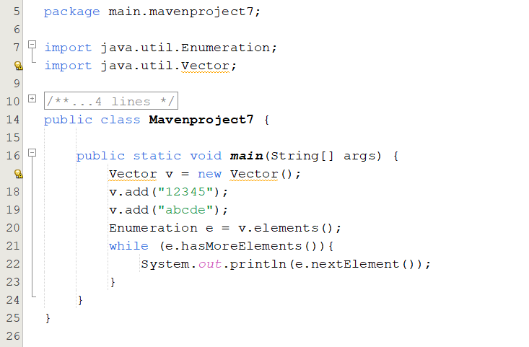
Utility Classes Example

Slide 14
Iterator
public interface Iterator
An iterator over a collection. Iterator takes the place of Enumeration in the Java collections framework. Iterators differ from enumerations in two ways:
Iterators allow the caller to remove elements from the underlying collection during the iteration with well-defined semantics.
Method names have been improved.

Slide 15
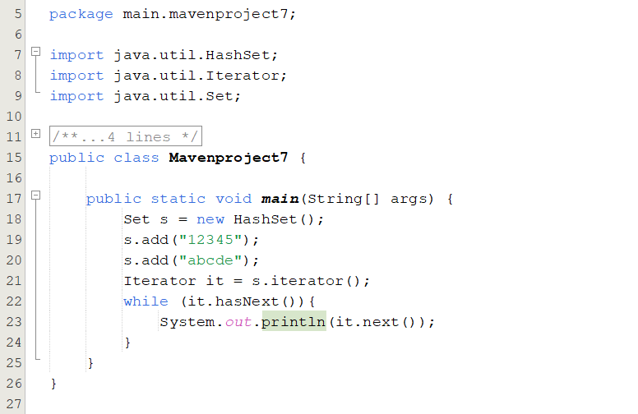
Iterator Example

Slide 16
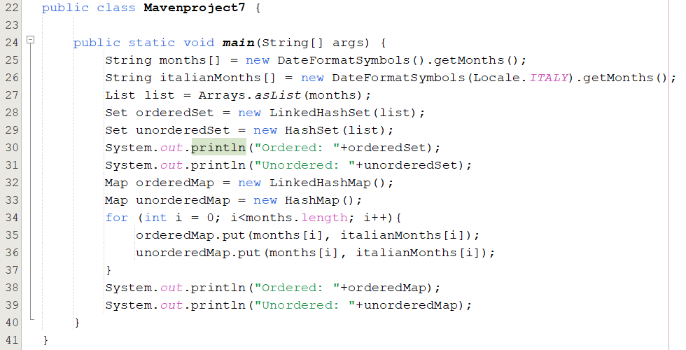
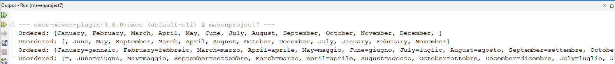
LinkedHashMap Example

Slide 17
Exercise
Create an interface called Transaction that contains two methods: getQuantity and getValue.
Create Purchase and Sale class that implement Transaction interface.
In your program, fill a list with Purchase and Sale objects with random value, and then create two method: getTotalQuantity and getTotalValue(), where their values calculated using Transaction interface.

Slide 18
Thank you
Bayu Rimba Pratama, ST, M.Kom
bayuforest@gmail.com

